Slide 1
Topology Optimization using the Level Set and Extended Finite Element Methods
Theory and Applications
Hernan Villanueva
January 9th, 2015

Slide 2
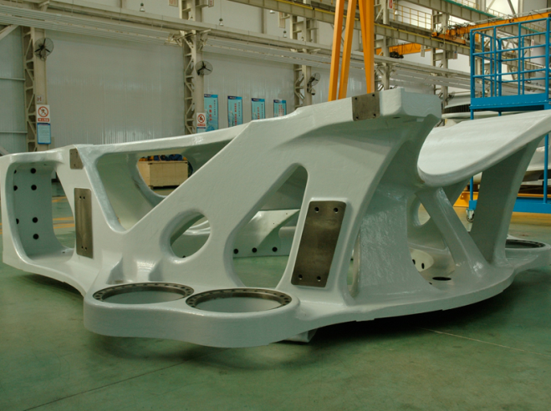
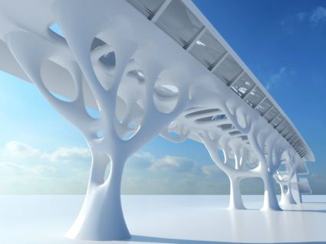
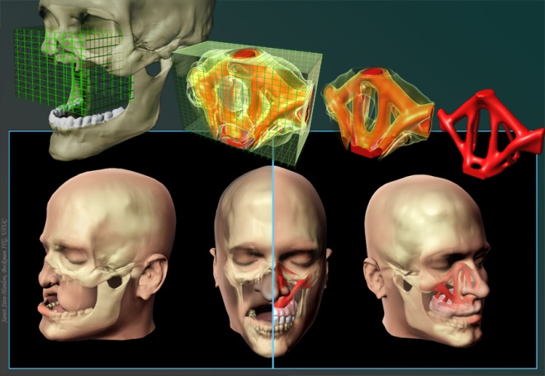
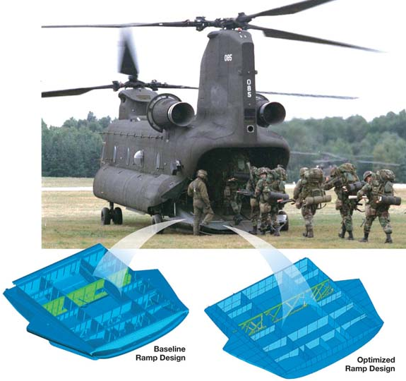
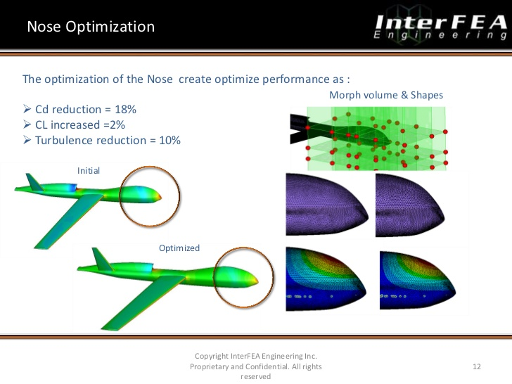
Optimization
Design problems are found in all branches of engineering.
Wind turbine component
Architectural design
Initial
Facial reconstruction surgery.
Optimized
Drones
Helicopter ramps
Notes:
Let me begin my presentation by introducing the context of my work.
My work focuses on optimization.
Design problems are found in all branches of engineering.
So optimization problems, problems that seek the best design possible, have found a multitude of applications.
Ranging from the military, to architecture, wind turbines, and even bioengineering.
Motivating slides:
What is topology optimization?
Examples.
Material and components design.

Slide 3
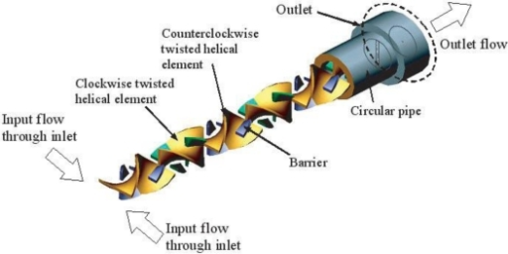
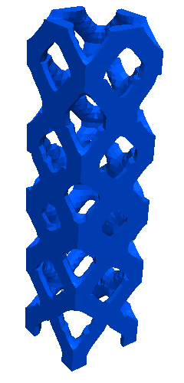
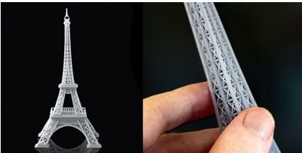
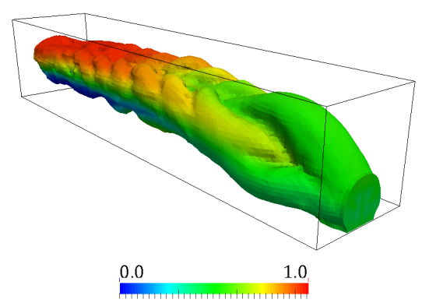
Topology optimization
Design domain
Objectives
Design
goal
find
given
Geometry of Structure
Constraints
Micromixer.
3D printer tower
Notes:
Within the scope of optimization, I focus on topology optimization.
Topology optimization essentially can be defined a design goal that seeks to find a geometry definition within a design domain.
Given objectives and constraints.
Within topology optimization, I’m interested in:
Complex.
Multiphysics problems.
Emphasis on 3D printing.
As it is a hot topic right now.

Slide 4
Topology optimization
Optimization model
Design model
Fabrication model
Analysis model
Computational approach:
Parametrization and shape control.
Design variables definition.
Formulation of optimization problem.
Search strategy.
Density
Level set
Multiscale and multiphysics analysis.
Fabrication constraints and costs.
Notes:
The computational model of topology optimization consists of three parts:
Design model, which deals with parametrization of the problem and definition of the design variables.
Fabrication model, which deals with fabrication and costs.
And an analysis model which deals with the multiscale and multiphysics analysis.
All models overlap with the optimization model which handles the formulation of the problem and the search strategy.
My work will focus on the optimization formulation, the parametrization and design variables, and the analysis.
Within all the approaches in topology optimization, I will study density and level set methods.

Slide 5
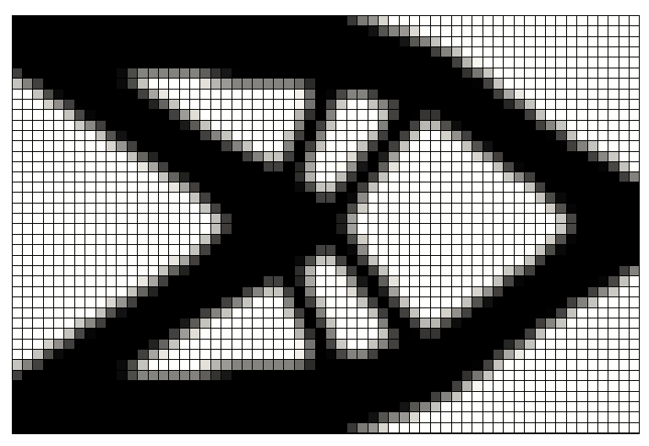
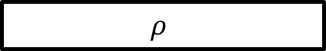
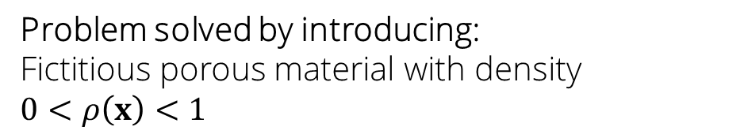
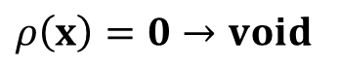
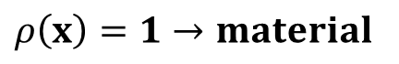
Density topology optimization
Problem solved by introducing:
Fictitious porous material with density $0<ρ\left(x\right)<1$
$$ρ$$
$$ρ\left(x\right)=1→material$$
Discretized with elements/nodes.
$$ρ\left(x\right)=0→void$$
Treated as design variables.
Optimum density distribution is found by a nonlinear mathematical programming algorithm.
Notes:
Basic concepts.
The design goal is to find the geometry of a structure within a design domain for a given objective and constraint.
The problem is solved by introducing a fictitious porous material with density rho which varies from zero to one.
The density distribution is discretized and the elemental/nodal densities are treated as design variables.
The optimum density distribution is found by a NLP.
An example for this approach is shown.

Slide 6
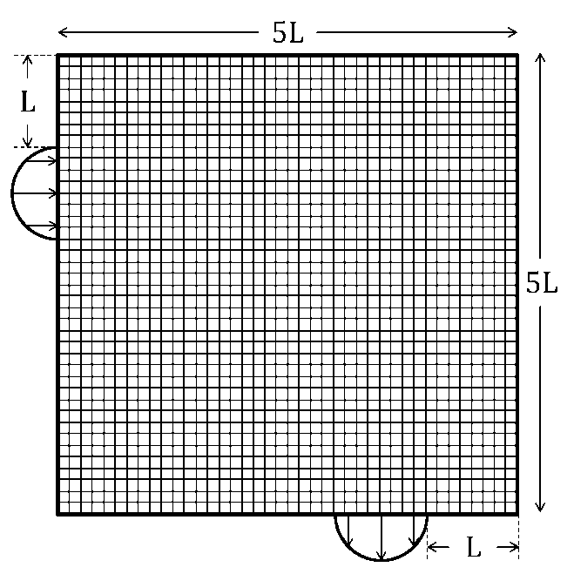
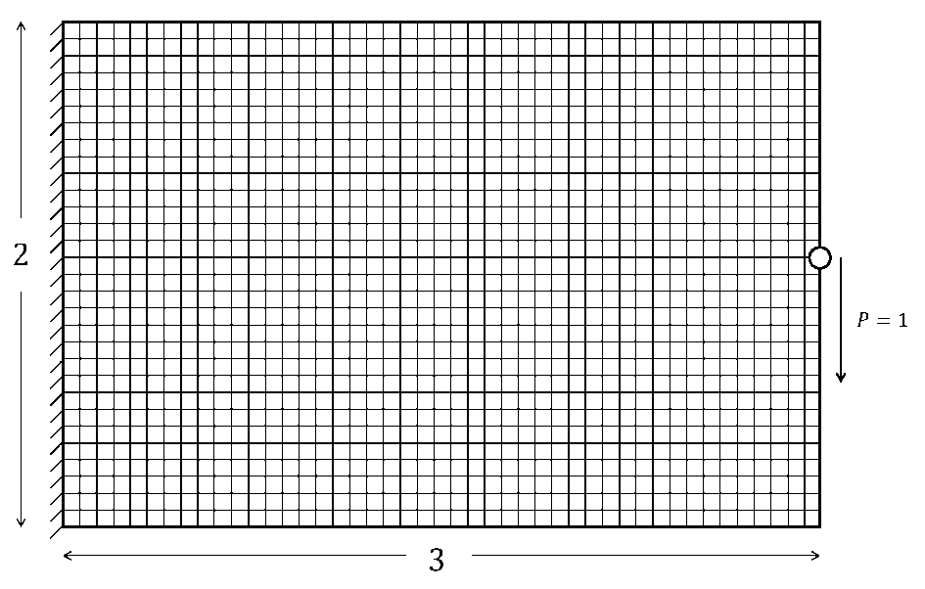
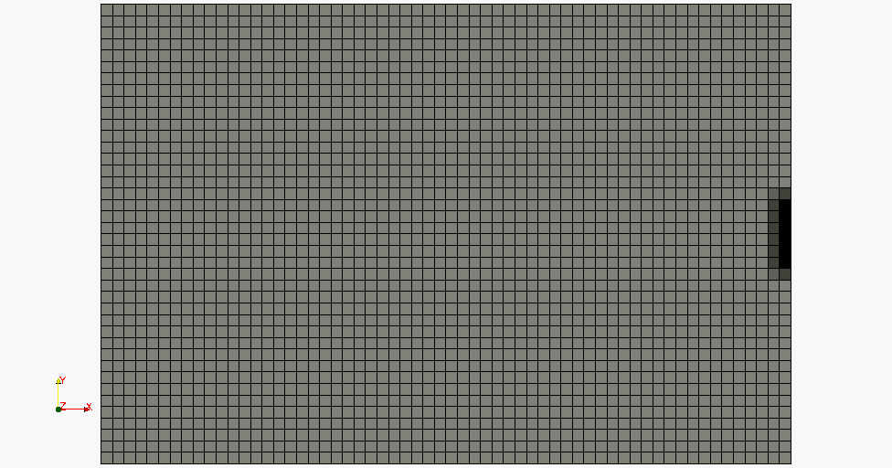
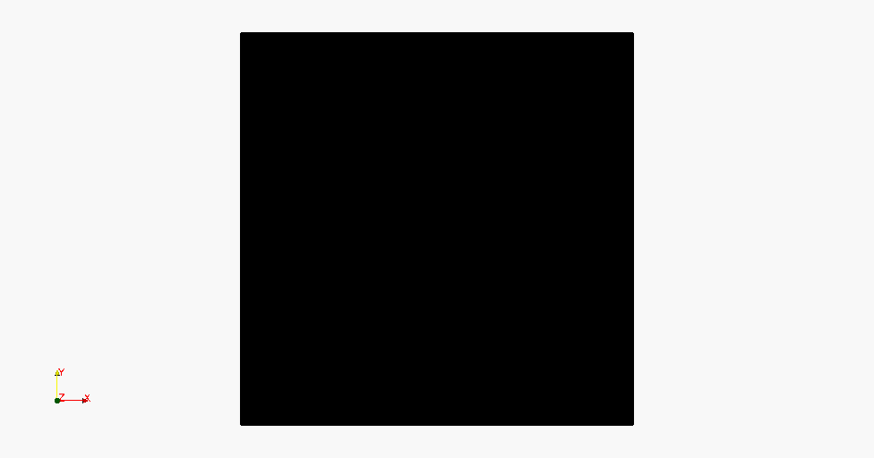
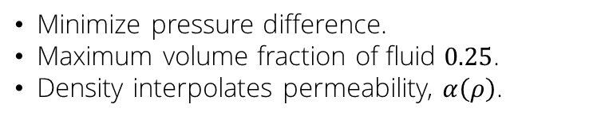
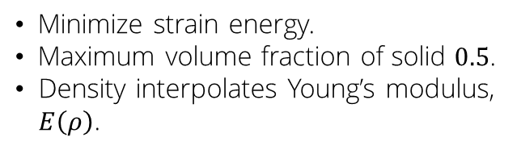
Topology optimization examples
Structural linear elasticity
Incompressible Navier-Stokes
Minimize strain energy.
Maximum volume fraction of solid $0.5$.
Density interpolates Young’s modulus, $E\left(ρ\right)$.
Minimize pressure difference.
Maximum volume fraction of fluid $0.25$.
Density interpolates permeability, $α\left(ρ\right)$.
Notes:
Let me illustrate topology optimization with two optimization examples in structural linear elasticity and incompressible Navier-Stokes.
As the optimization problem converges, the design moves toward a 0-1 material definition.
Application examples.
Structural topology optimization example: linear elasticity, problem setup and optimized result; density interpolates Young’s modulus.
Flow topology optimization example: Navier-Stokes model, problem setup and optimized result; density interpolates permeability.

Slide 7
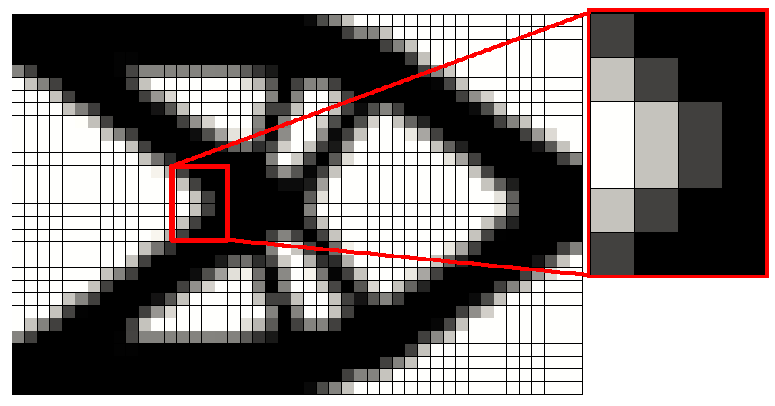
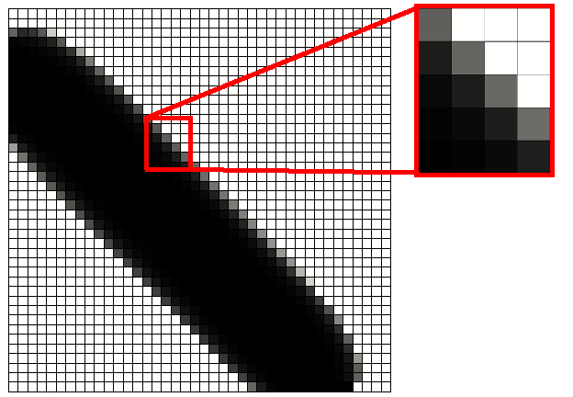
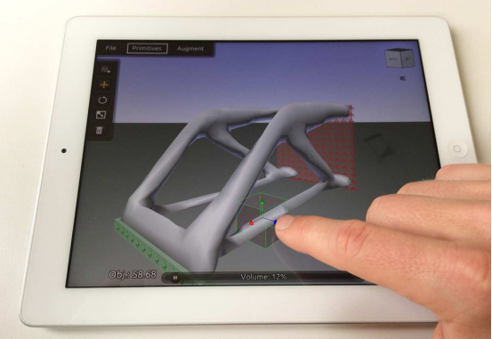
Density approach issues
Pros
Cons
Simple.
Used broadly.
Interactive design tools.
Fuzzy or jagged boundaries.
Affects accuracy of FE predictions.
At material interface.
Pronounced effect in nonlinear problems.
Mitigation: mesh refinement. 
Requires post-processing for manufacturing.
Interpolation schemes are problem dependent (physics, objectives & constraints).
App for iOS.
Notes:
The density method has some pros and cons.
Among the pros are that the method is simple,
used broadly,
and even has interactive design tools,
like app for iPhones.
Among the cons are that the method causes fuzzy or jagged boundaries.
Which affect the accuracy of finite element predictions,
Especially at the material interface and for nonlinear problems.
A way to mitigate this is to introduce mesh refinement; however that can be tricky and expensive for 3D.
The method requires postprocessing to extract the design from the pixelated model and manufacture it.
And as shown in the example before, the interpolation schemes are problem dependent, as well as physics, objectives, and constraints.
Issues.
Pros: simple, used broadly, allows even for interactive design tools.
Con: Fuzzy or jagged boundaries, affects accuracy of FE predictions (nonlinear problems: yielding, buckling, flow instabilites), requires post-processing for manufacturing

Slide 8
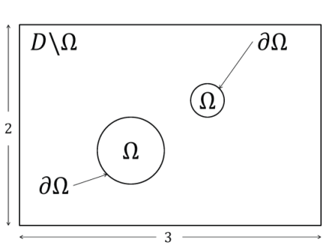
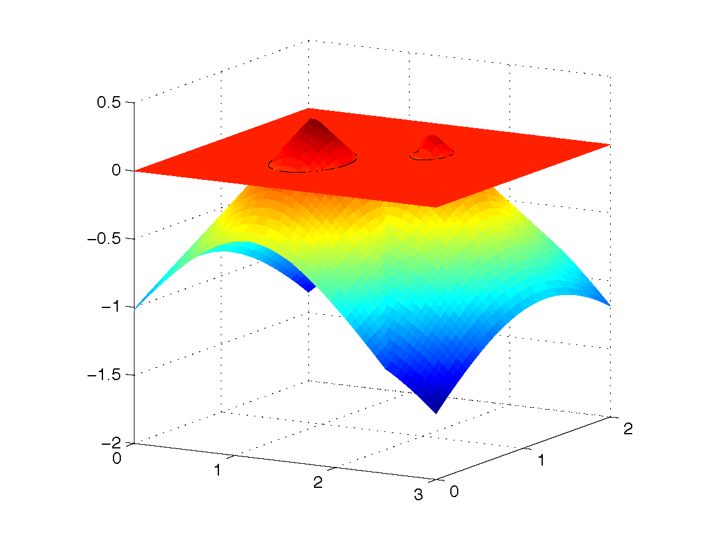
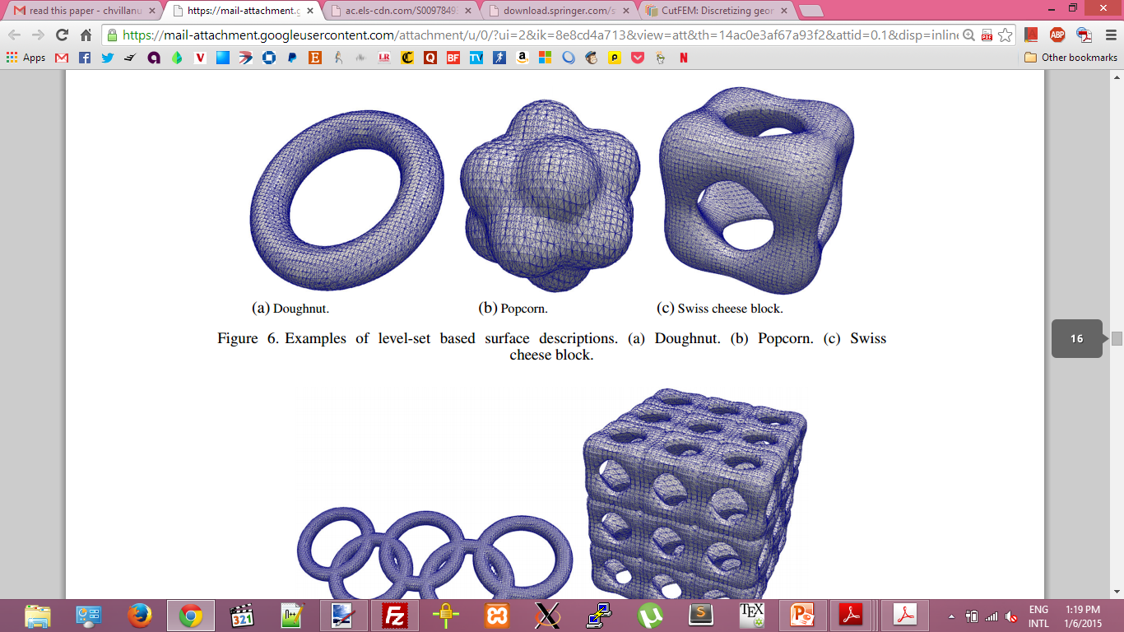
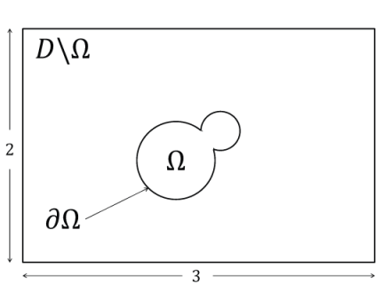
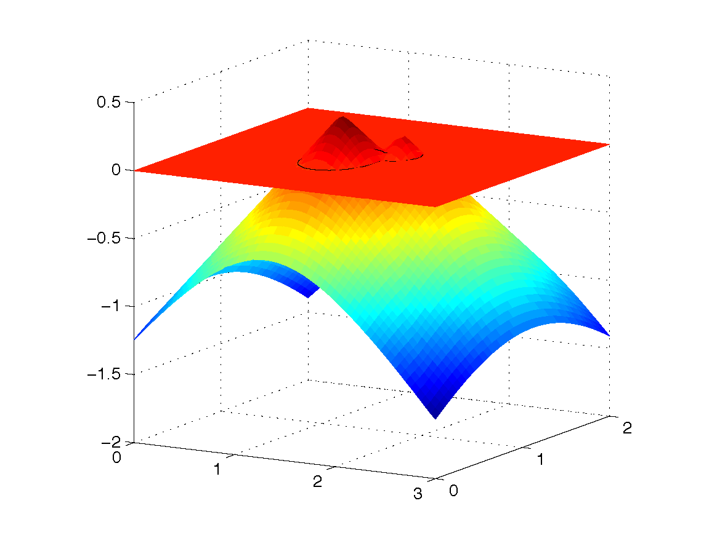
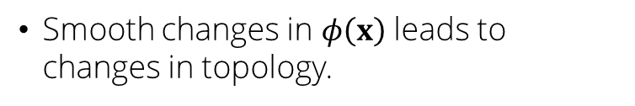
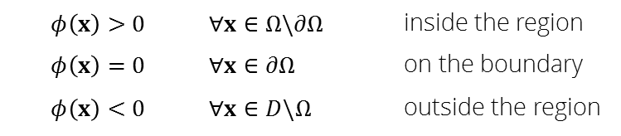
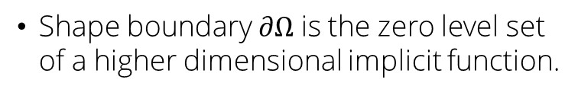
Level set method
Shape boundary $∂Ω$ is the zero level set of a higher dimensional implicit function.
Can represent complex shapes.
$$φ\left(x\right)>0$$ | $$∀x∈Ω\backslash ∂Ω$$ | inside the region
$$φ\left(x\right)=0$$ | $$∀x∈∂Ω$$ | on the boundary
$$φ\left(x\right)<0$$ | $$∀x∈D\backslash Ω$$ | outside the region
Smooth changes in $φ\left(x\right)$ leads to changes in topology.
Notes:
The level set was applied to topology optimization as an alternative to density methods.
The level set method provides a crisp definition of the interface, by introducing the shape boundary as the zero level set of a higher dimensional function.
For example, on the figure on the right I have two three dimensional cones, that when projected to my 2D mesh, form circles.
We can then define the material layout with respect to the sign of the level set.
The level set method is useful because it can represent complex geometries with a function.
It can form holes, merge, and smooth changes in the function leads to changes in topology, which is useful for the optimization process.
Level set method.
How are topologies represented.
Examples complex geometries functions.
Region definition.
Example of topology changes.
Alternative to geometry description of density methods.
Form holes.
Split into multiple pieces.
Merge with other level set functions.

Slide 9
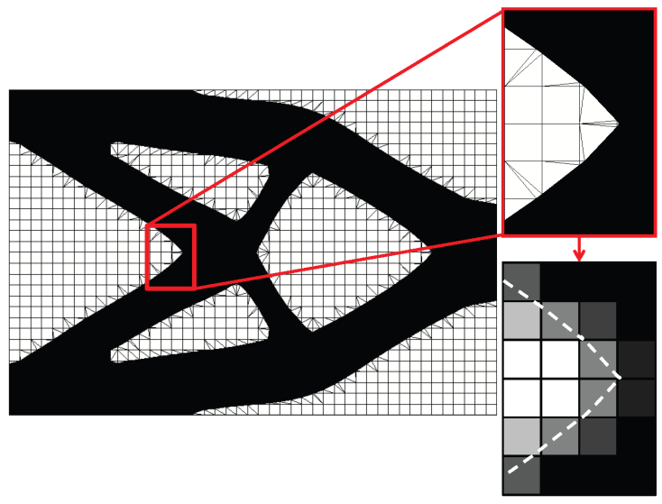
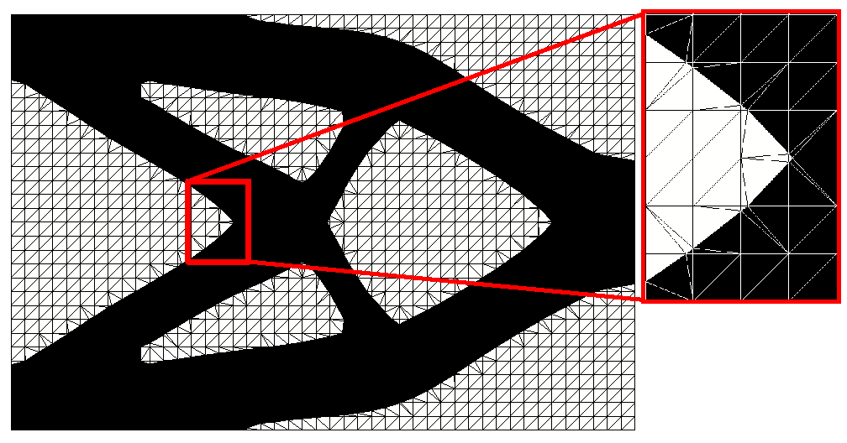
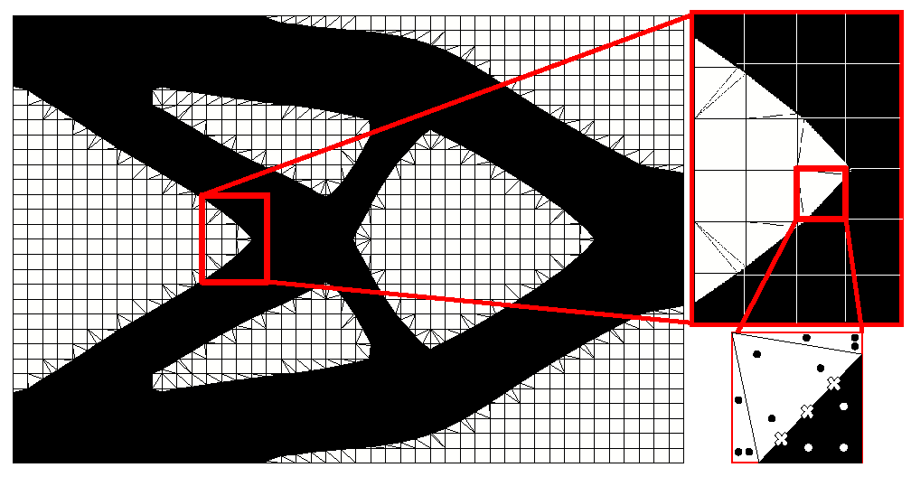
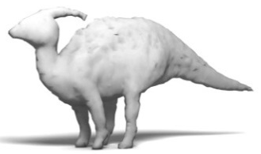
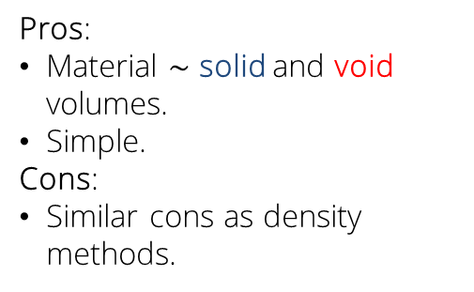
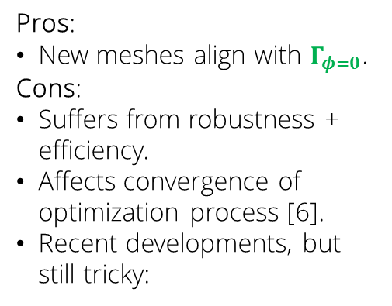
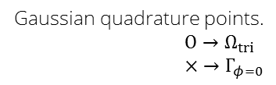
Material representation comparison:
Ersatz material, remeshing, XFEM
Ersatz material
Remeshing
XFEM
Pros:
New meshes align with $Γ_{φ=0}$.
Cons:
Suffers from robustness + efficiency.
Affects convergence of optimization process [6].
Recent developments, but still tricky:
Gaussian quadrature points.
$$O→Ω_{tri}$$
$$× →Γ_{φ=0}$$
Pros:
Material $\sim$ solid and void volumes.
Simple.
Cons:
Similar cons as density methods.
Immersed boundary technique.
Decomposes finite elements into subdomains and interfaces for integration.
Toy models optimized with remeshing.
Notes:
Now, the level set method provides a definition of the geometry.
What we need now is to map these geometries to material properties.
I will explain here three methods, the Ersatz material, remeshing techniques, and the extended finite element method.
In Erstaz material interpolation, the material is proportional to the solid and void volumes.
However, it provides a fuzzy definition of the interface
And suffer from the same issues as density methods.
In remeshing techniques, new meshes are generated that align with the zero level set.
The cons are that it suffers from robustness and efficiency,
And affects the convergence of the optimization process.
Recent developments have appeared in the literature, such as a study on the design of toys, however it is still tricky.
On the hand, the XFEM is an immersed boundary technique. And overcomes the limitations of the previous two methods by decomposing the finite element into subdomains and interfaces for integration. As you can see in the figure, integration points are placed at the subdomains of the element and the interface.
Pros and cons of each interpolation method.
Preamble to why is there a need for yet another interpolation method.
Ersatz material.
Remeshing.
XFEM.
Pros and cons.
Notes:
Toy models optimized with remeshing to improve balance while maintaining the initial shape.

Slide 10
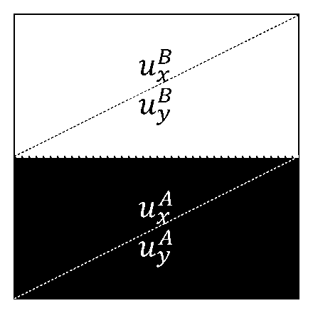


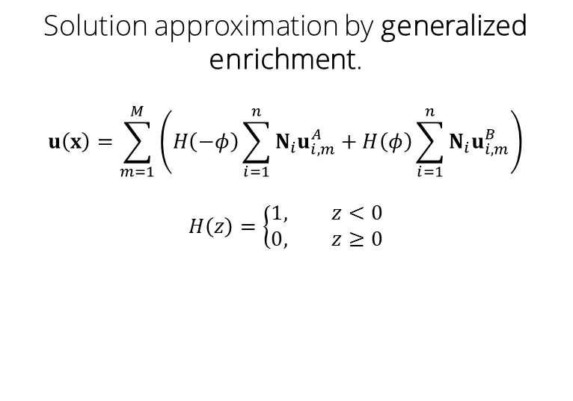
XFEM solution approximation
$$u\left(x\right)$$
$$u\left(x\right)$$
Kinks
Jumps
Solution approximation by generalized enrichment.
$$u\left(x\right)=\sum_{m=1}^{M}{\left(H\left(−φ\right)\sum_{i=1}^{n}{N_{i}u_{i,m}^{A}}+H\left(φ\right)\sum_{i=1}^{n}{N_{i}u_{i,m}^{B}}\right)}$$
$$H\left(z\right)=\left\{\begin{aligned}1, z<0 \\ &0, z≥0\end{aligned}\right.$$
Notes:
The last topic I want to discuss in this introduction is how the XFEM approximates solutions.
Take for example a two dimensional finite element, intersected by a level set field in the middle. We use a generalized enrichment formulation to approximate the solution. This equation basically expresses that we require as many extra enriched degrees-of-freedom as there are discontinuities in the domain.
All of algorithms related to XFEM, such as decomposition, and enrichment strategies to determine discontinuities have been applied to two dimensional successfully.
However, it is not a trivial exercise to expand to 3D due to the high algorithmic complexity of the method. I will not into the details, just believe me when I tell you that I actually had dreams about this stuff. But please, feel free to ask questions about the implementation after the presentation.
XFEM decomposition and solution approximation.
How are elements discretized?
How are the solutions interpolated from the element?

Slide 11
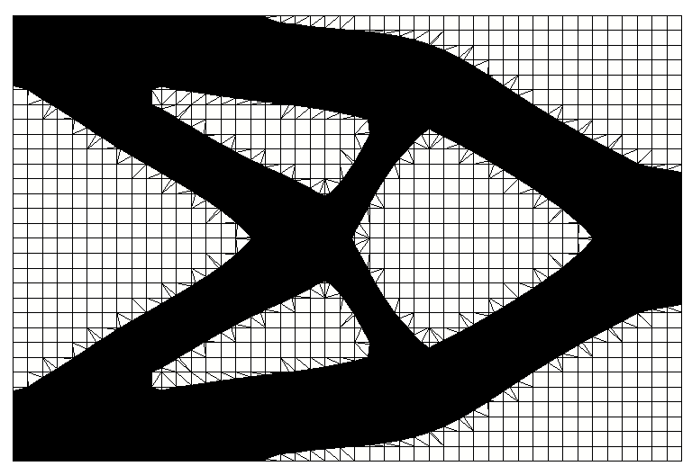
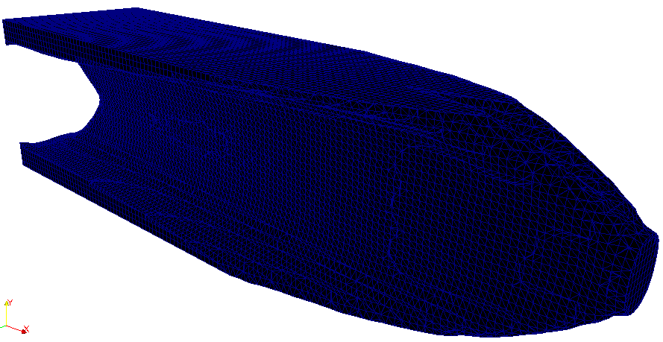
XFEM solution approximation
Has been implemented in 2D.
High algorithmic complexity in 3D.
Notes:
All of algorithms related to XFEM, such as decomposition, and enrichment strategies to determine discontinuities have been applied to two dimensional problems successfully.
However, it is not a trivial exercise to expand to 3D due to the high algorithmic complexity of the method. I will not go into the details, just believe me when I tell you that I actually had dreams about this stuff. But please, feel free to ask questions about the implementation after the presentation.
XFEM decomposition and solution approximation.
How are elements discretized?
How are the solutions interpolated from the element?

Slide 12
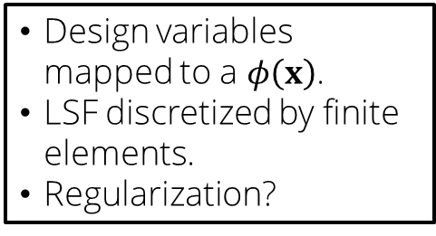
The LSM-XFEM framework
Design variables mapped to a $φ\left(x\right)$.
LSF discretized by finite elements.
Regularization?
LSF parametrization
Physical model
Geometry mapping
Discretized PDE
XFEM.
Generalized enrichment strategy.
Stab. Lagrange, Nitsche, ghost penalty.
Optimization model
Sensitivities
Update procedure
Adjoint method.
Solved by Nonlinear Programming Methods.
GCMMA.
Notes:
Now that I have defined the level set method and the extended finite element method, I can explain the framework upon which I will develop the work of this thesis.
We will use a level set function parametrization,
which will be used in the physical model to map the geometry and solve the discretized PDEs.
Later the optimization model will use the information of the physical model to compute sensitivities,
And update the design.
For the parametrization of the level set function, I will use design variables that map to a level set value,
And the resulting level set field will be discretized using finite elements.
We will apply regularization techniques to the level set field and I will discuss these later.
For the physical model, we will use the XFEM with a generalized enrichment strategy to describe the multiple discontinuous regions that may appear during the optimization process.
We will study stab. Lagrange multipliers, the Nitsche method, and ghost penalty formulation to describe the physics at the interface. These are penalty methods added to the weak form of the PDEs. I will not go into the theory of Lagrange multipliers and Nitsche methods, but feel free to ask me after the presentation.
LSM-XFEM framework.
Level set discretization.
XFEM model.
Optimization model.

Slide 13
Goals and Approach
Notes:
In this section, I will discuss the goals of this thesis proposal and the approaches I will take to reach those goals.

Slide 14
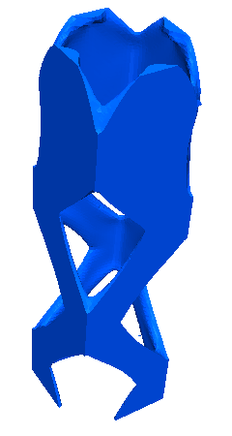
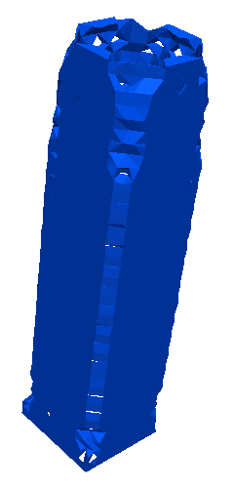
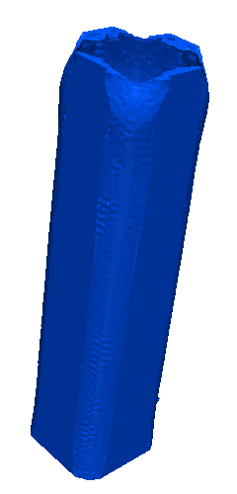
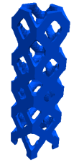

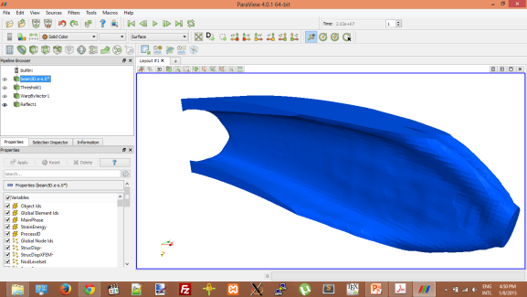

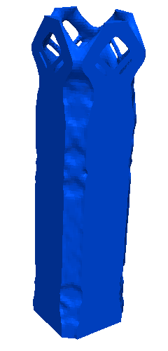
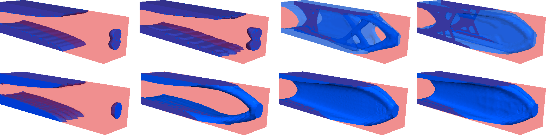
Goals and objectives
LSM-XFEM topology optimization framework
Genericity
Efficiency
Robustness
Applicable to broad range of problems.
Ability to control shape.
Reduce computational cost against density methods.
2D and 3D.
Ability to accurately predict relevant physical phenomena.
Convergence of optimized geometry with mesh refinement.
Material-material.
Accurate enforcement of boundary conditions.
Notes:
The goal of this thesis proposal is to expand and study the LSM-XFEM topology optimization framework with respect to the following characteristics: genericity, efficiency, and robustness.
We will measure genericity by the ability of the framework to be applicate to a broad range of problems with different physical phenomena, to be applicable to 2D and 3D problems, and to material-void and material-material problems.
We will measure efficiency by the ability of the method to reduce computational cost against density methods, and the convergence of the optimized geometry with mesh refinement.
Finally, we will measure the robustness of the method by its ability to control the shape of the design, its ability to predict relevant physical phenomena, and enforce boundary conditions.
Create and study a:
Generic.
Efficient.
Robust.
In contrast with density methods:
Requires a different interpolation scheme for each physics.
Structural linear elasticity: $E\left(x\right)={\tilde{ρ}}^{p}E_{A}+\left(1−{\tilde{ρ}}^{p}\right)E_{B}$
Incompressible Navier-Stokes: $α\left(γ\right)=α_{max}+γ∙\left(α_{min}−α_{max}\right)\frac{1+α_{p}}{γ+α_{p}}$
Applicable to broad range of problems undergoing various physical phenomena.

Slide 15




Approach
Develop 3D XFEM.
Perform case studies on problems in solid and fluid mechanics.
LSM-XFEM framework
Generic
Efficient
Robust
Integrate and study state of art boundary formulations.
Study regularization techniques.
Design-build-test a real-world design problem.
Compare the framework with traditional density methods.
Study the advantages and disadvantages.
vs.
Notes:
To reach the stated goals, I will follow this approach:
With respect to the genericity of the framework, I will expand XFEM to 3D, and perform case studies in solid and fluid mechanics.
With respect to the robustness, I will integrate and study state-of-the-art boundary formulations, regularization, and the design-build-test process of a real-world design problem.
Finally, with respect to the efficiency, I will compare the framework with traditional density methods, and study the advantages and disadvantages of both.

Slide 16


Overview
Case I:
Linear elasticity
Develop 3D XFEM.
Compare LSM-XFEM framework against density.
Study shape control and regularization.
Case II:
Incompressible Navier-Stokes with scalar transport
Integrate and study state-of-the art boundary formulations.
Case III:
Design-build-test
Design-build-test a real-world design problem.
Notes:
So allow to give you an overview of how the rest of this presentation is structured.
Each one of the approaches stated before will be studied in the context of a case study.

Slide 17
Case study I
Structural linear elasticity topology optimization

Slide 18
Goals and objectives
Physics: Study a structural linear elastic optimization problem.
Motivation:
Density methods require post-processing for manufacturing.
Density methods require extensive mesh refinement to mitigate issues with jagged boundaries.
Open issues:
Comparison against density methods.
Convergence rates?
Shape control?
Postprocessing for manufacturing?
Influence of initial design?
Approach:
Implement algorithms for LSM-XFEM framework in 3D.
Compare LSM-XFEM framework against density methods.
Notes:
Goals and objectives of structural linear elasticity.
Hypothesis: Issues were presented in introduction.
What are we studying?
Approach.
Areas of research.

Slide 19



Initial design influence / convergence rate
“Solid-void” problem.
Minimize $ℱ_{SE}(+ℱ_{P})$
Maximum stiffness for given mass $10\%$
$65×65×65$
Issue:
Design sensitivities differ from zero near the interface.
No new domains of solid can emerge.
Approach:
Seeding the initial design with several void areas.
Notes:
The first open issue we will explore is the influence of the initial design and the convergence rate of the optimization process.
Our problem is a cube anchored on its four bottom corners and subject to a point load in its bottom face.
The objective is to minimize the strain energy, and in case of XFEM, to minimize the area of the level set surface.
The first issue we encounter is that design sensitivities only differ from zero near the interface.
Therefore, no new domains of solid can emerge, only possible to merge existing.
Our approach to this issue is to seed the initial design with several void areas as shown in the picture.
Initial design importance / influence.
Convergence rate of density vs. XFEM.

Slide 20





Initial design influence / convergence rate
Density
$$ℱ_{SE}=3.5519×{10}^{−2}$$
LSM-XFEM
$$ℱ_{SE}=3.5244×{10}^{−2}$$
Similar shapes.
Strain energies are similar.
Convergence is faster.
Notes:
In here we can see the optimized geometries for both density and XFEM.
Notice that the designs and strain energies are similar.
However, it seems the XFEM converges to a optimal design faster than density.
Initial design importance / influence.
Convergence rate of density vs. XFEM.

Slide 21











Convergence of design wrt mesh
Density
$$ℱ_{SE}=2.6555×{10}^{3}$$
$$40×10×10$$
$$60×15×15$$
$$80×20×20$$
$$120×30×30$$
$$ℱ_{SE}=9.8262×{10}^{2}$$
Density design changes with mesh refinement because of $r_{ρ}$.
In XFEM, only local details are improved.
LSM-XFEM
Minimize $ℱ_{SE}(+ℱ_{P})$
Maximum stiffness for given mass $10\%$
Notes:
Now, we study the converge of the design with respect to the mesh.
Our problem setup is a building under torsion. The objective is the same, to minimize strain energy, and area in XFEM. The maximum volume is 10%.
In density, the design changes as we refine the mesh, while in XFEM only local details are improved. XFEM prefers designs with thin walls.
Now, to explain why this happen in density I need to explain the concept of smoothing filter.
a. Mesh convergence.

Slide 22




Smoothing filter
Computes physical properties.
Weighted average of design variables.
Within smoothing radius, $r_{ρ}\left(h\right)$ or $r_{φ}\left(h\right)$.
$$ρ$$
$$φ$$
Prevents formation of features smaller than $r_{ρ}$.
At cost of intermediate (“grey”) densities.
As we refine the mesh, $r_{ρ}→$ smaller $→$ smaller features, such as thin walls.
Did not provide a minimum feature size control.
Troublesome for manufacturing.
Yields similar results for both coarse and fine meshes
Notes:
The smoothing filter computes the physical properties, such as rho or phi, as a weighted average of the design variables within a smoothing radius, which we will define as r_rho and r_phi. These radii are usually defined as functions of the element scale.
In SIMP, r_rho prevents formation of features smaller than $r_{ρ}$, at cost of intermediate (“grey”) densities. So you can see that as we refine the mesh, r_rho is smaller as a function of the element scale, and therefore allows for smaller features, such as thin walls.
In XFEM, however, r_phi does not control the shape and yields similar results for both coarse and fine meshes.

Slide 23






Smoothing filter / feature size control
$$120×30×30$$
Density approach leads to the same layout for a mesh independent filter.
Increasing $r_{φ}$ results in a less smooth design.
$r_{φ}$ does not control shape.
Density
LSM-XFEM
$$r_{ρ}=0.16$$
$$r_{φ}=0.16$$
Notes:
Our next step is to study the influence of the smoothing filter on the shape of the design.
If we use a larger filter on the density in the 120x30x30 mesh, we get the same results as the coarse mesh with 40x10x10.
In XFEM, we get a less smooth design, however the overall shape is not modified.
We can conclude that the smoothing filter does not control the minimum feature size in XFEM.
a. Smoothing filter influence.

Slide 24





Issue: Controlling the shape of the level set function
We want to control the shape of the design through regularization techniques.
Minimize $ℱ_{SE}$
Minimize $ℱ_{SE}+ℱ_{P}$
Perimeter
$$ℱ_{P}=\int_{φ=0}{dΓ}$$
Open issues:
What are the effects of applying a perimeter constraint in 3D?
Does it provide local shape control? e.g. minimum feature size?
Curvature
$$ℱ_{n}=\int_{φ=0}{{\left\|\frac{dn}{ds}\right\|}^{2}dΓ}$$
Notes:
Now, to study shape control, again, we are going to take a step back and introduce another concept, which we discussed earlier. Regularization techniques for level sets.
The motivation is that we want to control the shape of the design. For example, consider this linear elastic optimization problem in which strain energy was minimized. There are some numerical artifacts present.
We introduce two regularization techniques. Perimeter / area and curvature measures. While perimeter has been used extensively in the literature, curvature is an approach we wish to develop.
As you can in this figure, a perimeter minimization reduces the artifacts and yields a smoother result.
Open issues are ...
We will go back to the concepts behind curvature later.
Regularization
What is the issue? Show example.
Hypothesis.
Why do we want regularization?
Regularization techniques.
Open issues.

Slide 25



Initial design / feature size control
$$120×30×30$$
Constrain the perimeter $𝒢_{P}$ using perimeter from density.
Open issues:
Neither perimeter constraint nor smoothing control the local feature size.
Effect of a perimeter constraint is non-intuitive.
Approach:
A minimum feature size control approach is outside the scope of this work.
LSM-XFEM restarted from density design.
LSM-XFEM restarted from XFEM design.
Notes:
In this study, we feed our LSM-XFEM framework two different designs, and minimize strain energy subject to an area constraint.
One example gets a density-like design, while the other one gets the XFEM one.
Notice that the perimeter constraint does not control the local feature size. The first example does not change much and converges to a local minima. While the second example generates truss-like shape at the bottom, but prefers thin walls at the top.
The development of a minimum feature size control is outside the scope of this work.
Now, let’s explore the other regularization technique, curvature, as a shape control method.
a. Feature size control.

Slide 26













Shape control: How do we measure $n$?
From the level set
From the geometry
$$n_{φ}$$
$$n_{u}$$
$$n_{g}$$
Enforced in the strong form with $N$.
$$n_{φ}=\frac{∇φ}{\left\|∇φ\right\|}$$
Enforced in the weak form.
$$\int_{Ω}{δn_{u}\left(n_{u}\left\|∇φ\right\|−∇φ\right) dΩ}$$
Model interface as structural linear beam elements.
$$n_{ψ}$$
Project $φ$ with hyperbolic tangent function.
$$ψ\left(φ\right)=\frac{1}{2}\left(\tanh\left(\frac{φ}{2ε}\right)+1\right)$$
Enforce same as $n_{u}$.
$$ℱ_{κ}=\int_{φ=0}{{\left\|\frac{dn}{ds}\right\|}^{2}dΓ}=\frac{1}{2}\int_{φ=0}{σ:ε}dΓ$$
$$φ$$
$$ε=4.0$$
Open issues:
Influence of computing $n$ from the level set vs. geometrically on the smoothness measure?
Notes:
Building upon shape control techniques, we introduce a curvature measure.
The curvature technique measures the change in the normal of the level set field. We define the normal as the gradient of the level set field, and define two way to compute it.
From the level set field.
From the geometry.
From the level set field, we compute the normal in three different ways:
One approach computes the normal in the strong form using the shape functions.
Another approach computes the normal in the weak form.
The last approach uses a smooth Heaviside function to project the level set field, and then enforces the normal in the weak form.
From the geometry approach, we model the interface as structural linear beam elements, and formulate the curvature as a strain energy measure.

Slide 27






Preliminary results
Minimize $ℱ_{SE}+ℱ_{κ}$ using $n_{u}$
Minimize $ℱ_{SE}+ℱ_{κ}$ using $n_{g}$
$ℱ_{κ}$ using $n_{u}$ yields a smooth design yet with a few kinks.
$ℱ_{κ}$ using $n_{g}$is computed directly at the intersection points.
Smoother results.
Open issues:
Too smooth? 
Penalize only sharp corners?
Notes:
Preliminary results show that minimizing curvature yields smoother designs.
Using $n_{u}$ yields a few kinks, while $n_{g}$ yields designs that are too smooth.
Our approach to mitigate this will be to penalize intermediate curvatures.

Slide 28








Two-phase problem / manufacturing
Manufacturing example of a two-phase “solid-solid” problem using 3D printing.
How do we extract optimized geometries from the design domain?
Density
$$\frac{E^{A}}{E^{B}}=0.5$$
$$\frac{E^{A}}{E^{B}}=0.1$$
$$\frac{E^{A}}{E^{B}}=0.01$$
$$E^{b}=void$$
Minimize $ℱ_{SE}(+ℱ_{P})$
Maximum stiffness for given mass $30\%$
$120×30×30$
Extract surface through isolevels of $ρ$.
Choosing correct value of $ρ$ not trivial.
LSM-XFEM
Extract threshold of subdomains for specific region.
Notes:
Finally, the last part of our study is a two-phase material-material problem, and its manufacturing capabilities.
We test our LSM-XFEM framework with a beam anchored to a wall and subject to a point load. We use different stiffness ratios for the materials in both density and the LSM-XFEM framework.
Again, notice density approaches favor truss-like structures, while XFEM favors thin walls.
The process to extract the design geometry in density methods is to extract a surface isolevel of the density, which is not always a trivial exercise.
In XFEM, however, the geometry is already defined so it’s straightforward to extract the surface with any visualization tool, and manufacture it using 3D printing.
Two-phase optimization.
Postprocessing.

Slide 29
Case Study II
Incompressible Navier-Stokes and scalar transport

Slide 30
Goals and objectives
Study the characteristics of the LSM-XFEM framework for three dimensional incompressible Navier-Stokes flow and scalar transport problems.
Enforcement of boundary conditions at the phase interface for high Reynolds number flow.
Motivation:
Density methods in fluids, such as the Brinkman penalization cause spurious pressure diffusion through solid material.
Approach:
LSM-XFEM framework.
Study the correct enforcement of boundary conditions.

Slide 31







Pipebend and diffuser
“Fluid-solid” problem.
Minimize $ℱ_{PD}$.
Maximum volume fraction of fluid phase 25% and 50%.
$Re=1.0$
Pipebend
Diffuser
Initial designs.
Fluid
Solid
Fluid
Solid

Slide 32





Pipebend and diffuser
Identical results for Stokes and Navier-Stokes formulation with $Re=1.0$.
Open issues:
Higher $Re$ flow does not converge for certain topologies.
Oscillations occur near interface.
Approach:
Explore Nitsche method for enforcing continuity at interface.
Use face-oriented ghost penalty to increase stability.
Notes:
Pipebend results.
Diffuser results.
Issue: Higher Re flows do not converge.
Approach to mitigate issue.

Slide 33








Micromixer
Fluid region
Temperature
Minimize:
$$ℱ_{TSV}=\frac{1}{β}ln\left(\int_{Γ}{e^{β{(T−T_{ref})}^{2}}dΓ}\right)$$
Maximum volume fraction of fluid phase 50%.
$Re=1.0$
Open issues:
Same as issues as pipebend and diffuser problems for higher $Re$. 
Top
Bottom
Streamlines
Identical results for Stokes and Navier-Stokes formulation with $Re=1.0$.
Notes:
Pipebend results.
Diffuser results.
Issue: Higher Re flows do not converge.
Approach to mitigate issue.

Slide 34




Approach: Face-oriented ghost-penalty
Objective:
Overcome stability issues on cut elements for viscous flows.
Method used for single enrichment diffusion and incompressible Navier –Stokes flow [8].
Hypothesis:
Smoothing the gradient of the solution across the element facets reduces condition number.
Can the method reduce wiggling in design?
Open issues:
Expand methodology to 3D.
Apply method in topology optimization.
With multiple enrichment functions.
For incompressible Navier-Stokes:
$$\sum_{l∈\left\{A,B\right\}}{\sum_{m=1}^{M}{\sum_{F∈{ℱ_{G}}_{m}^{k}}{\sum_{i=1}^{D}{\int_{F}{α_{GP,μ}μ^{l}h_{F}^{2\left(i−1\right)+1}\left[\frac{∂^{i}N}{{∂x}^{i}}\right]∙n_{F}:\left[\frac{∂^{i}u_{m}^{l}}{{∂x}^{i}}\right]∙n_{F} ds}}}}}+\sum_{l∈\left\{A,B\right\}}{\sum_{m=1}^{M}{\sum_{F∈{ℱ_{G}}_{m}^{k}}{\sum_{i=1}^{D}{\int_{F}{α_{GP,μ}{μ^{l}}^{−1}h_{F}^{2i+1}\left[\frac{∂^{i}N}{{∂x}^{i}}\right]∙n_{F}:\left[\frac{∂^{i}p_{m}^{l}}{{∂x}^{i}}\right]∙n_{F} ds}}}}}$$
Notes:
What is ghost penalty? Method to overcome stability issues.

Slide 35
Case Study III
Design-build-test real-world engineering problem

Slide 36


Atomic Layer Deposition
ALD is a thin film deposition technique in which two or more chemicals react with the surface of a material.
Issues:
Machine has open boundaries which may cause reactions with air.
Lead to imperfections in the deposition.
Approach:
Model an incompressible Navier-Stokes flow problem with multiple scalar transport fields.
Model interaction of multiple reactants with outside sources.
Holes at the top are inlets through which the chemical reactants enter.
Conveyor belt moves a web on which the chemicals are deposited.

Slide 37




Model problem
Scalar transport equation:
$$\frac{∂c}{∂t}−u∙∇c−d∇^{2}c−q=0$$
where $c$ is the species concentration and $d$ is the diffusivity.
The inflow velocity of the inlets is:
$$u_{{inlet}_{z}}=1.0∗0.53\frac{m}{s}$$
Material properties:
$$ν_{N2}=1.52∙{10}^{−5}\frac{m^{2}}{s}$$
$$ρ_{N2}=1.16\frac{kg}{m^{3}}$$
$$d_{N2,H2O}=2∙{10}^{−5}\frac{m^{2}}{s}$$
$$y$$
$$x$$

Slide 38

Atomic Layer Deposition
Open issues:
Expand our scalar transport model to simulate multiple scalar transport fields.
$$\frac{∂c}{∂t}−u∙∇c−d∇^{2}c−q=0$$
Research the interaction of the reactant with the outside sources, such as air.
Optimize the layout of the gas source heads.
Formulate optimization problem for minimizing mixing of reactants with outside sources.

Slide 39
Conclusions

Slide 40
Conclusions
The LSM can describe the geometry and the XFEM can predict the structural response.
Built upon generalized enrichment formulation.
Applied method to:
Two-phase “material–void” and “material–material” problems in 3D.
Structural linear elasticity.
Incompressible Navier-Stokes flow.
Scalar transport.

Slide 41

Is it generic?
Used the same optimization approach for:
Multiphysics problems.
Two-phase “material–void” and “material–material” problems.
2D and 3D problems.
LSM can describe complex geometries.
XFEM can model discontinuities with generalized enrichment strategy.

Slide 42


Is it efficient?
Method is significantly more complex in regards of implementation.
Similar assembly time for “material–void ” problems.
More time for “material–material” due to larger linear system.
Faster optimization convergence rate.
Ability to represent thin-walled structures on coarse meshes.
Alternative to density methods for problems where a high mesh resolution is not tolerable.

Slide 43


Is it robust?
Open issues:
Smoothing filter and perimeter constraint do not control local feature size.
Outside the scope of this work.
Interface conditions need to be enforced accurately for nonlinear problems.
Using $n_{g}$ may yield too smooth designs.

Slide 44


Is it robust?
Remaining work:
Case I:
Linear elasticity
Case II:
Incompressible Navier-Stokes with scalar transport
Case III:
Design-build-test
Study stress constraints with face-oriented ghost penalty . Summer 2015.
Study influence of $n$.
Penalize intermediate curvatures. March 2015.
Explore Nitsche method for interface physics in higher $Re$ flow May 2015.
Explore face-oriented ghost penalty to increase stability in higher $Re$ flow March 2015.
Expand to multiple scalar transport fields.
Research the interaction of the reactant with the outside sources.
Formulate and study optimization problem. December 2015.

Slide 45
Bibliography
Hansbo A, Hansbo P (2004) A finite element method for the simulation of strong and weak discontinuities in solid mechanics. Computer methods in applied mechanics and engineering 193(33):3523-3540
Kreissl S, Pingen G, Maute K (2011) An explicit level set approach for generalized shape optimization of fluids with the lattice boltzmann method. International Journal for Numerical Methods in Fluids 65(5):496-519
Lang C, Makhija D, Doostan A, Maute K (2013) A simple and efficient preconditioning scheme for heaviside enriched XFEM. Computat Mech.
Makhija D, Pingen G, Yang R, Maute K (2012) Topology optimization of multicomponent flows using a multi-relaxation time lattice boltzmann method. Computers & Fluids 67(0):104-114
Maute K, Schwarz S, Ramm E (1998) Adaptive topology optimization of elastoplastic structures. Structural and Multidisciplinary Optimization 15(2):81-91
Schleupen A, Maute K, Ramm E (2000) Adaptive fe-procedures in shape optimization. Structural and Multidisciplinary Optimization 19:282-302
Wilke DN, Kok S, Groenwold AA (2006) A quadratically convergent unstructured remeshing strategy for shape optimization. International journal for numerical methods in engineering 65(1):1-17
Burman E, Hansbo P (2012) Fictitious domain nite element methods using cut elements: II. a stabilized Nitsche method. Applied Numerical Mathematics 62(4):328-341.
Schott B, Rasthofer U, Gravemeier V,WallW(2014) A face-oriented stabilized Nitsche-type extended variational multiscale method for incompressible two-phase ow. International Journal for Numerical Methods in Engineering.

Slide 46
BACKUP slides

Slide 47


Slide 48

$ℱ_{SE}=\int{\frac{1}{2}}σ\left(x\right) : ε\left(x\right) dΩ$
$𝒢_{s}=\frac{\int{ρd}Ω}{0.5\int{d}Ω}<1$
$F_{PD}=\frac{\int_{Γ_{in}}{\left(p+\frac{ρ{\left|u\right|}^{2}}{2}\right)dΓ}}{\int_{Γ_{in}}{dΓ}}−\frac{\int_{Γ_{out}}{\left(p+\frac{ρ{\left|u\right|}^{2}}{2}\right)dΓ}}{\int_{Γ_{out}}{dΓ}}$
$α_{max}≈{10}^{4}$
$α_{min}=0$
$α_{p}=0.01$

Slide 49








Incompressible Navier-Stokes flow topology optimization
Minimize pressure difference:
$F_{PD}=\frac{\int_{Γ_{in}}{\left(p+\frac{ρ{\left|u\right|}^{2}}{2}\right)dΓ}}{\int_{Γ_{in}}{dΓ}}−\frac{\int_{Γ_{out}}{\left(p+\frac{ρ{\left|u\right|}^{2}}{2}\right)dΓ}}{\int_{Γ_{out}}{dΓ}}$
Satisfy equations:
$$ρ\left(\frac{∂u}{∂t}+u∙∇u\right)=−∇p+μ∇^{2}u−αu$$
Subject to $𝒢_{s}=\frac{\int{γd}Ω}{0.25\int{d}Ω}<1$
Design variables are the porosity of the finite elements.
$$γ\left(x\right)=1.0→fluid.$$
$$γ\left(x\right)=0.0→solid.$$
Brinkman coefficient uses interpolation to avoid large gradients in flow.
$$α\left(γ\right)=α_{max}+γ∙\left(α_{min}−α_{max}\right)\frac{1+α_{p}}{γ+α_{p}}$$
$$u_{x}=1$$
$$α_{max}=\left(1+\frac{1}{Re}\right)∙{10}^{4}$$
$$α_{min}=0$$
$$α_{p}=0.01$$
$$p=0$$
$40×40$ quadrilateral linear elements
Optimized geometry.

Slide 50

Density optimization methods
Jagged boundaries cause:
Premature yielding in structural mechanics due to stress singularities (Maute et al., 1998).
Fluid flow penetrating solid material in low Reynolds number flow (Kreissl and Maute, 2011) .
Scalar fields diffusing through solid material at low Péclet number flow (Makhija et al., 2012).
Especially in nonlinear problems.
These problems can be overcome by adaptive remeshing.
Expensive for three dimensional problems.
Density methods implemented in most commercial software; apps on iOS.
Interface between different material domains represented by using intermediate (“grey”) densities $→$ jagged boundaries.
Enforcement of boundary conditions at the interface is hindered.

Slide 51
Motivation
Topology optimization:
formulation of optimization problem + physics / mechanics
Material and component design examples.
Cast structure for a wind turbine.
Architectural structure with an organic design.
Initial
Model custom bone replacement implants for facial reconstruction surgery.
Optimized
10% reduction in turbulence by optimizing nose of drone.
Baseline ramp design
Optimized ramp design
Notes:
Motivating slides:
What is topology optimization?
Examples.
Material and components design.

Slide 52
Topology optimization
Find a realizable distribution and geometry of materials and components with desired functionality.
Computational approach:
Optimization model
Design model
Fabrication model
Analysis model
Parametrization and shape control.
Design variables definition.
Formulation of optimization problem.
Search strategy.
Multiscale and multiphysics analysis.
Fabrication constraints and costs.

Slide 53






Geometry representation comparison: density and level set
Design variables, $s\left(x\right)$, are associated with nodes in these examples.
Density method
Level set method
$$φ\left(s\right)=\frac{\sum_{i=1}^{N}{w_{i}s_{i}}}{\sum_{i=1}^{N}{w_{i}}}$$
$$w_{i}=\max_{}\left(\begin{aligned}0, \\ r_{φ}−\left\|x_{i}−x\right\|\end{aligned}\right)$$
Does not provide a minimum feature size control.
$$\tilde{ρ}\left(s\right)=\frac{\sum_{i=1}^{E}{w_{i}s_{i}}}{\sum_{i=1}^{E}{w_{i}}}$$
$$w_{i}=\max_{}\left(0,r_{ρ}−\left\|x_{i}−x\right\|\right)$$
Prevents formation of features smaller than $r_{ρ}$.
At cost of intermediate (“grey”) densities.
$Γ_{φ=0}$ divides the fixed mesh grid into different phase regions: $Ω^{A}$ and $Ω^{B}$.
Each phase represents a different material, i.e. solid and void.
$Γ_{φ=0}$ represents the zero level set isolevel of the level set function $φ\left(x\right)$.

Slide 54
$Γ_{φ=0}$ divides the fixed mesh grid into different phase regions: $Ω^{A}$ and $Ω^{B}$.
Each phase represents a different material, i.e. solid and void.
$Γ_{φ=0}$ represents the zero level set isolevel of the level set function $φ\left(x\right)$.

Slide 55


Topology optimization examples
Structural linear elasticity
Incompressible Navier-Stokes
Minimize strain energy.
Maximum volume fraction of solid $0.5$.
Density interpolates Young’s modulus.
$$E\left(x\right)=ρ^{p}E_{A}+\left(1−ρ^{p}\right)E_{B}$$
$p≥3$ recovers binary distribution.
$E_{B}=0$ for void material.
Minimize pressure difference.
Maximum volume fraction of solid $0.25$.
Density interpolates permeability.
$$α\left(ρ\right)=α_{max}+ρ∙\left(α_{min}−α_{max}\right)\frac{1+α_{p}}{ρ+α_{p}}$$
Notes:
Application examples.
Structural topology optimization example: linear elasticity, problem setup and optimized result; density interpolates Young’s modulus.
Flow topology optimization example: Navier-Stokes model, problem setup and optimized result; density interpolates permeability.

Slide 56


Design variables and physical variables
Generic approach is to consider $s\left(x\right)$ the design variables.
Design variables $→$ Physical model (i.e. $ρ$, $φ$)
Density method
Level set method
$$\tilde{ρ}\left(s\right)=\frac{\sum_{i=1}^{E}{w_{i}s_{i}}}{\sum_{i=1}^{E}{w_{i}}}$$
$$w_{i}=\max_{}\left(0,r_{ρ}−\left\|x_{i}−x\right\|\right)$$
Prevents formation of features smaller than $r_{ρ}$.
At cost of intermediate (“grey”) densities.
$$φ\left(s\right)=\frac{\sum_{i=1}^{N}{w_{i}s_{i}}}{\sum_{i=1}^{N}{w_{i}}}$$
$$w_{i}=\max_{}\left(0,r_{φ}−\left\|x_{i}−x\right\|\right)$$
Does not provide a minimum feature size control.
Notes:
Geometry representation comparison.
SIMP smoothing filter.
Level set smoothing filter.
$ρ$ as design variable only make sense in density methods.

Slide 57





XFEM decomposition and solution approximation
The decomposition of an element is defined by the level set function.
$$u\left(x\right)$$
$$u\left(x\right)$$
Solution approximation by standard enrichment.
$$u\left(x\right)=H\left(−φ\right)\sum_{i=1}^{n}{N_{i}u_{i}^{A}}+H\left(φ\right)\sum_{i=1}^{n}{N_{i}u_{i}^{B}}$$
$$H\left(z\right)=\left\{\begin{aligned}1, z<0 \\ &0, z≥0\end{aligned}\right.$$
Kinks
Jumps
Notes:
XFEM decomposition and solution approximation.
How are elements discretized?
How are the solutions interpolated from the element?

Slide 58

Issue: XFEM implementation in three dimensions
Objective:
Expand the triangulation, enrichment, and preconditioner formulations to 3D.
Open issues:
What is the algorithmic complexity?
Use computer vision algorithms to “see” disconnected phase regions?
How expensive is it computationally?
Intersection pattern can be numerous and complex in three dimensions.
Notes:
What do we want? Expand to 3D.
Is it trivial to expand from 2D to 3D?

Slide 59



Approach: generalized enrichment strategy for 3D XFEM
Grounded on flood fill computer vision algorithm.
Several implementation algorithms attempted.
Latest version reduced computation time from ~10 minutes on average to milliseconds.
Intersection configuration
Local elemental enrichment
Nodal cluster enrichment
Notes:
Enrichment
How? Flood fill.
Complexity? Several algorithms attempted.
Example / description.

Slide 60






Issue: generalized description of discontinuities
Two dimensional structural linear elastic problem with four quadrilateral elements.
Multiple disconnected regions of the same phase may appear during optimization.
Approach:
Augments the standard function space with additional “enriched” degrees-of-freedom.
Heaviside enrichment formulation of Hansbo and Hansbo (2004).
$$u\left(x\right)=\sum_{m=1}^{M}{\left(H\left(−φ\right)\sum_{i=1}^{n}{N_{i}u_{i,m}^{A}}+H\left(φ\right)\sum_{i=1}^{n}{N_{i}u_{i,m}^{B}}\right)}$$
Phase “A” |  | Phase “B”
$$u_{x_{0}}^{A}$$ | $$u_{x_{0}}^{A}$$ | $$u_{x_{0}}^{B}$$ | $$u_{x_{0}}^{B}$$
$$u_{x_{1}}^{A}$$ | $$u_{x_{1}}^{A}$$ | $$u_{x_{1}}^{B}$$ | $$u_{x_{1}}^{B}$$
$$u_{x_{2}}^{A}$$ | $$u_{x_{2}}^{A}$$ | $$u_{x_{2}}^{B}$$ | $$u_{x_{2}}^{B}$$
$$u_{x_{3}}^{A}$$ | $$u_{x_{3}}^{A}$$ | $$u_{x_{3}}^{B}$$ | $$u_{x_{3}}^{B}$$
$$u_{x_{4}}^{A}$$ | $$u_{x_{4}}^{A}$$ | $$u_{x_{4}}^{B}$$ | $$u_{x_{4}}^{B}$$
Center node uses different dofs to describe disconnected phase regions.
Subscripts denote the $m$ enrichment level.
Maximum number of enrichment levels for each phase $M=5$.
$$m$$ | : | Enrichment level.
$$M$$ | : | Maximum number of enrichment levels for each phase.
$$u_{i,m}^{l}$$ | : | Vector of degrees-of-freedom.
$$l=[A,B]$$ | : | Phase region.
$∎$ Active for phase “A”.
$∎$ Active for phase “B”.
$∎$ Inactive.
Notes:
Adaptive mesh refinement also resolves artificial stiffening issue, but it is less attractive for topology optimization.
Generalized description of continuities.
Why? Multiple disconnected regions.
How? Augment space, use Heaviside enrichment.
Example.

Slide 61






Issue: Ill-conditioned analysis problems
Changes in topology may cause vanishing zone of influence for certain degrees-of-freedom. 
Ill-conditioning is more pronounced in 3D (more intersection patterns).
Approach:
Balance the influence of all degrees of freedom in the system (Lang et a., 2013).
$$T_{i,m}^{l}={\left(\max_{e∈E_{i}}{\frac{\int_{Ω_{e,m}^{l}}{∇N_{i}\left(x\right)∙∇N_{i}\left(x\right)dx}}{\int_{Ω_{e}^{}}{∇N_{i}\left(x\right)∙∇N_{i}\left(x\right)dx}}}\right)}^{−1/2}$$
$$E_{i}$$ | : | Set of elements connected to node $i.$
$$Ω_{e,m}^{l}$$ | : | Element domain of phase $l$.
Constraint degrees-of-freedom
$$T_{i,m}^{l}>T_{tol}$$
Example of vanishing zone of influence for $u_{x_{1}}^{B}$ and $u_{x_{1}}^{B}$.
The condition number of the stiffness matrix increases. 
Preconditioner expanded to 3D and built upon enrichment information.
Notes:
Topology changes may cause small intersection regions.
Issue is pronounced in 3D due to intersections.
Condition number goes up.
Approach: Use preconditioner from Lang et al.
Example.

Slide 62





Issue: Ensure continuity of solution at phase boundary $Γ_{φ=0}$
$$u\left(x\right)$$
$$u\left(x\right)$$
The Heaviside function allows for discontinuities of the states $u$ along the phase boundaries.
Kinks
Jumps
Hypothesis:
Can we accurately enforce boundary conditions on the phase interface without extensive mesh refinement?
Can we ensure continuity of solution? $u^{A}=u^{B} on Γ_{φ=0}$ for “material-material” problems.
Approach:
Stabilized Lagrange multipliers.
$$\int_{φ=0}{δλ∙\left(λ−\left(\frac{1}{2}\left(σ^{A}+σ^{B}\right)\right)∙n_{Γ_{φ=0}}\right)dΓ}−\int_{φ=0}{δλ∙\left(u^{A}−u^{B}\right)dΓ}−\int_{φ=0}{δ\left(u^{A}−u^{B}\right)∙λdΓ}$$
Nitsche method (penalty enforcement).
Proper treatment of interface conditions is key to obtaining accurate solution gradient along interface. 
Notes:
Note that the standard Lagrange multiplier approach is not suitable for the XFEM as it suffers from numerical instabilities.
Issue is discontinuity due to Heaviside.
Hypothesis: Can we accurately enforce BCs without mesh refinment?
Approach: stabilized Lagrange and Nitsche.
Why is it important?

Slide 63




Issue: Controlling the shape of the level set function
Motivation:
Emergence of numerical artifacts in optimization problem.
Convergence to local minima.
Minimize $ℱ_{SE}$
Minimize $ℱ_{SE}+ℱ_{P}$
Hypothesis:
We can control the shape of the design through regularization techniques.
Objective:
Use regularization technique to:
Avoid local minima with poor performance.
Control geometrical properties.
Open issues:
What are the effects of applying a perimeter constraint in 3D?
Does it provide local shape control? e.g. minimum feature size?
$$ℱ_{P}=\int_{φ=0}{dΓ}$$
Perimeter
$$ℱ_{n}=\int_{φ=0}{∇∙n dΓ}$$
Curvature
Notes:
Regularization
What is the issue? Show example.
Hypothesis.
Why do we want regularization?
Regularization techniques.
Open issues.

Slide 64


Issue: Emergence of numerical geometrical artifacts
For “solid-void” problems, designs with free floating pieces of material may be generated in the course of the optimization process.
Causes ill-conditioning of the system.
Approach:
Adding soft springs between every material point and a fictitious support.
$$\int{k_{A}N∙udΩ^{A}}$$
$k_{A}$ denotes the stiffness of the distributed system of springs, ${10}^{−6}$, for all examples.
Minimize perimeter of $Γ_{φ=0}$ with $ℱ_{P}$.
Notes:
What is the issue?
Why is it important?
Approach: springs and perimeter.

Slide 65





Problem setup
$$ρ=1.0$$
$$μ=0.001$$
$$L=0.1$$
$$h=0.015$$
$$u_{x}=\frac{6uy\left(0.41−y\right)}{{0.41}^{2}}$$
$$u_{y}=0.0$$
$$0.41$$
$$2.2$$
$$0.2$$

Slide 66








QUAD4 $γ={10}^{+00}$
$$h=0.015$$
$$t=0.1$$
$$Bilinear λ$$
$$Volume λ$$
$$No area scaling$$
$$λ$$
$$σ$$

Slide 67












QUAD4 $γ={10}^{+00}$
$$λ$$
$$h=0.00375$$
$$t=0.1$$
$$Bilinear λ$$
$$Volume λ$$
$$No area scaling$$
$$σ$$
$$Scaled from:$$
$$Scaled from:$$

Slide 68








QUAD8 $γ={10}^{+00}$
$$h=0.015$$
$$t=0.1$$
$$Bilinear λ$$
$$Volume λ$$
$$No area scaling$$
$$λ$$
$$σ$$
$$Scaled from:$$

Slide 69






QUAD8 $γ={10}^{+00}$
$$λ$$
$$h=0.00375$$
$$t=0.1$$
$$Bilinear λ$$
$$Volume λ$$
$$No area scaling$$
$$σ$$
$$Scaled from:$$
$$Scaled from:$$

